Slide 1
IS 120
JavaScript APIs Continued / Wrap Up

Slide 2
Announcements
Project 3 due Tuesday
End of Semester One-on-Ones
April 16th 10:00am - 2:00pm, TNRB W223
https://docs.google.com/spreadsheets/d/1FhV_pm_LIKKX-gb1B4jymqmmHjV0Oho3QcdblIBq4cY/edit?usp=sharing

Slide 3
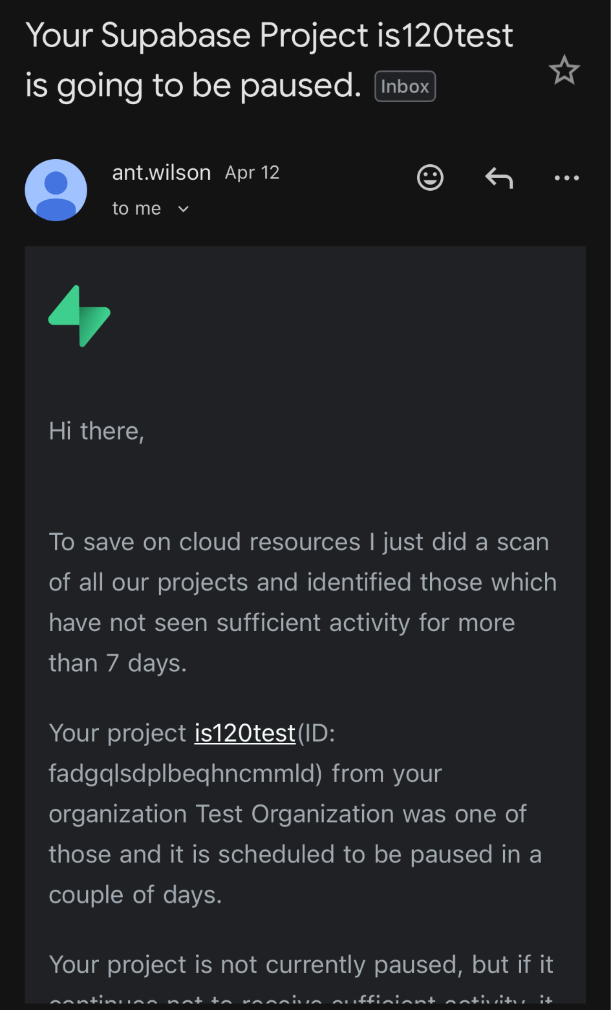
Supabase pauses projects that aren’t being frequently used
They don’t want inactive projects to take up space on their servers
This is how they help keep it free/cheap for their users

Slide 4
Project 3 - JavaScript CRUD
Slido
https://app.sli.do/event/v78Efm6AZjQZJBatzVw6Qw

Slide 5
Project 3 - JavaScript CRUD
Slido
https://app.sli.do/event/v78Efm6AZjQZJBatzVw6Qw
Other questions/things to review for Project 3?

Slide 6
AI APIs
We’re going to use Vercel AI Gateway
Allows us to pick different models instead of being locked down to a single provider (OpenAI, Anthropic, Google, etc.)
I am going to give you my PRIVATE API KEY
So please be careful and don’t charge me $100

Slide 7
AI API Demo

Slide 8
AI Programmer Tools
Types of tools
What I like
Demo

Slide 9
AI Programmer Tools
Normal Chat Based (ChatGPT, Claude, Gemini, Copilot)
Super helpful for Rubber Ducking
Great if you want to ask questions with no context
Planning an approach, testing ideas, deciding tools to use, breaking down a problem before looking at or writing any code

Slide 10
AI Programmer Tools
AI Coding Assistants
AI that lives with your code. Sometimes built into your IDE (like VS Code) or accessed with your terminal
Has full context of the current problem you’re trying to solve

Slide 11
AI Programmer Tools
Cursor -> Very popular. Fork of VS Code. Gained a lot of hype. Free tier not super generous. 1 year pro free
GitHub Copilot -> Works within VS Code, don’t have to switch. Widely adopted in enterprise. Free for students.
Claude Code -> Lives in the terminal. Only uses Claude models. Good for coding multiple things at once. No free tier.

Slide 12
AI Programmer Tools
Ask -> Like a normal chat with context of your codebase
Agent -> Actually writes and executes code for you. Can even execute in your terminal with your approval.
  Can be good for debugging if you’re really stuck.
  Can also get caught in a doom loop and basically dig itself a hole that it can never get out of

Slide 13
My Favorites
Claude -> Brief and to the point, tends to hallucinate less than others (ChatGPT). Great balance between critique and agreeing to everything. Decent free tier, rarely burn through.
GitHub Copilot -> Free for students! Has an Auto mode that selects the best model for the job, keeps usage low for small tasks. Almost always use Ask mode. I rarely use Agent and usually have to tweak output anyways. I wouldn’t use it if you don’t understand what it’s doing.

Slide 14
AI Programmer Tools
Honorable Mentions
  Google Stitch -> Website prototyping
  Loveable -> Complete app builder using prompts

Slide 15
AI Programming Demo

Slide 16
What Should You Learn After This Class?
Honestly, sticking with basic HTML, CSS, and JavaScript is not a bad idea
I’ve seen many developers cruise on to React or more backend stuff without learning basic frontend skills
I would focus more on getting a deeper understanding of a few skills than I would getting a general understanding of everything

Slide 17
What Should You Learn After This Class?
One of the best things you can do for yourself when the semester ends, is to ditch previous projects and start over
Keep picking things you’re passionate or care about first, and the new skills will follow
If you need to learn new tools to accomplish what you want, that’s great. But let that come naturally

Slide 18
Tailwind
https://youtu.be/mr15Xzb1Ook
A design system built using classes, no CSS needed
Great for fast iteration
AI uses this a lot
https://play.tailwindcss.com/

Slide 19
Sass (SCSS)
Syntactically Awesome Style Sheets
https://youtu.be/akDIJa0AP5c
Makes writing CSS a little easier
Adds new features that vanilla CSS doesn’t have
https://sass-lang.com/guide/

Slide 20
PWAs
Progressive Web Apps
https://youtu.be/sFsRylCQblw
Not crazy advanced from what we’re doing in this class
Could create something unique and different for your portfolio
This is where mobile development is slowly heading
Spotify, Uber, Starbucks, Google Maps, Trivago, etc.

Slide 21
TypeScript
https://youtu.be/zQnBQ4tB3ZA
JavaScript with guardrails
Super cool, but can be difficult to get used to
Often used with React

Slide 22
React
https://youtu.be/Tn6-PIqc4UM
Vanilla JavaScript can get messy
React helps you reuse elements called components
Minimizes a lot of complexity and allows you to group logic with it’s UI
https://react.dev/

Slide 23
What Should You Learn After This Class?
These are just some examples of what I think would be good next steps
If you really want to explore something specific, go for it
AI can be a great teacher and is really helpful for learning new technologies. Just don’t rely on it too much

Slide 24
Last Day of Class
Bring Switch controllers

